Slide 1
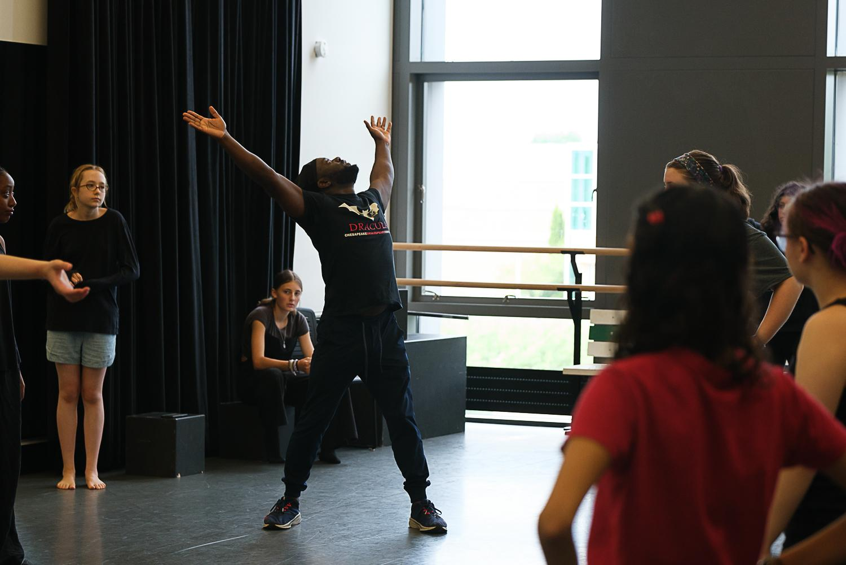
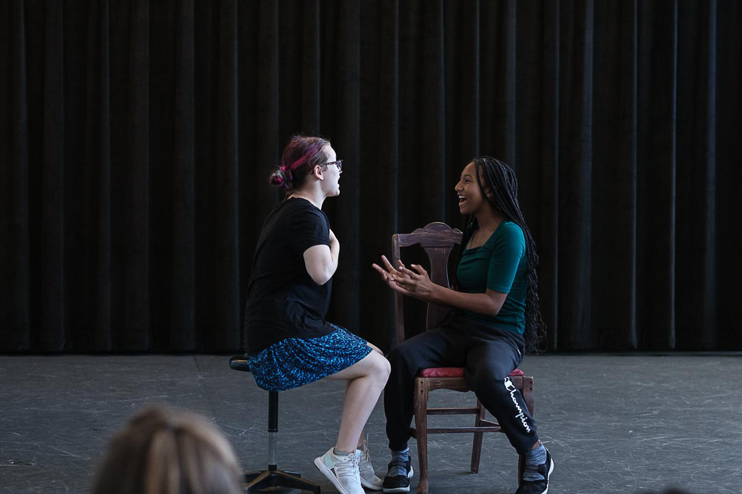
Portfolio Guide for 2025 THEATRE Applications
NEW YORK STATE
SUMMER SCHOOL OF THE ARTS

Slide 2
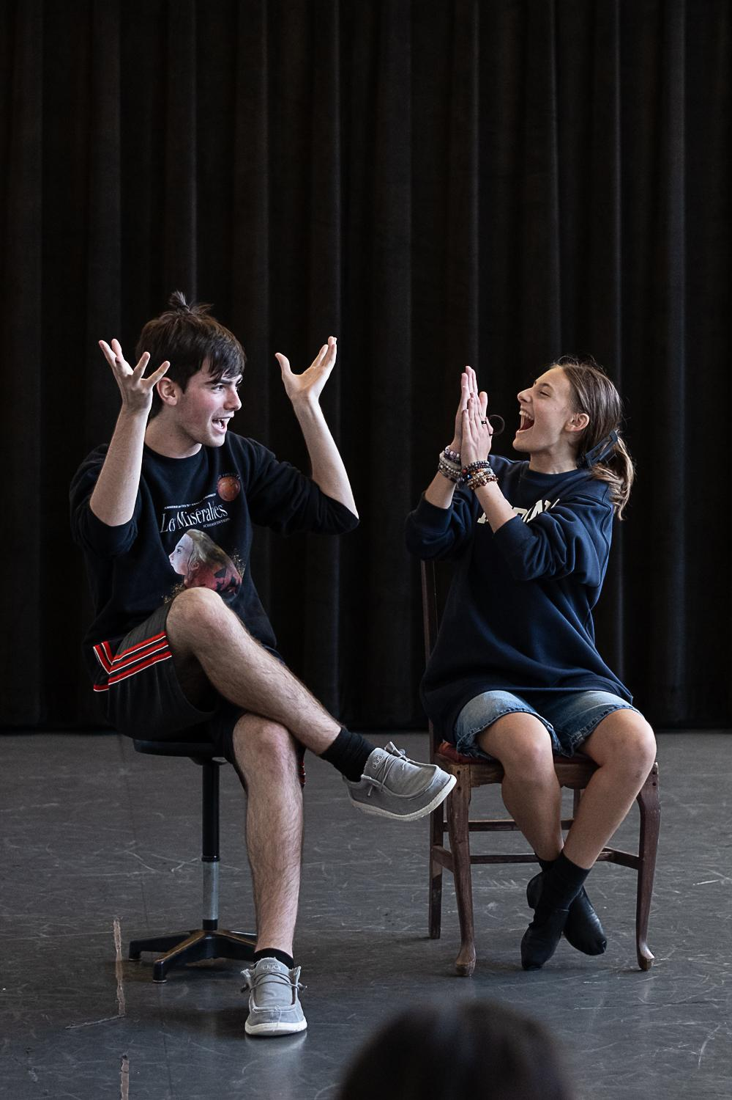
Audition Notes
Applicants must submit a recorded audition online consisting of both a memorized classical monologue and a contemporary monologue, each no longer than 2 minutes in length.
Selections should be from well-known, published plays (not musicals), and should reflect contrasting moods and/or characters.
Students will be rated on honesty, interpretation, diction/voice, and relaxation/concentration.
In addition to monologues, students must record themselves answering the following questions.
Why do you want to attend this program?
What do you expect from this program?
What shows have you done in the past year or two?
What show is your favorite and why?
Please tell us about someone who inspires you.

Slide 3
CREATE YOUR AUDITION PORTFOLIO
After you’ve downloaded this presentation, open it in Google Slides (File Open Upload)
Insert videos or links to your auditions.
Change the title of the presentation in the upper left corner of your screen using the format Lastname_Portfolio.
Check your sharing settings. Change to “anyone on the internet with this link can view.”
Make a Google folder titled as LastName_FirstName_SOT. Check the sharing settings on your Google folder. Change to “anyone on the internet with this link can view.” Place your slide show into the folder.
Share your folder with nysssa@nysed.gov

Slide 4
Classical Monologue Link
[Insert your link here or directly insert Google Drive video onto this slide]

Slide 5
Contemporary Monologue Link
[Insert your link here or directly insert Google Drive video onto this slide]

Slide 6
Application Interview Questions
[Insert your link here or directly insert Google Drive video onto this slide]

